Slide 1
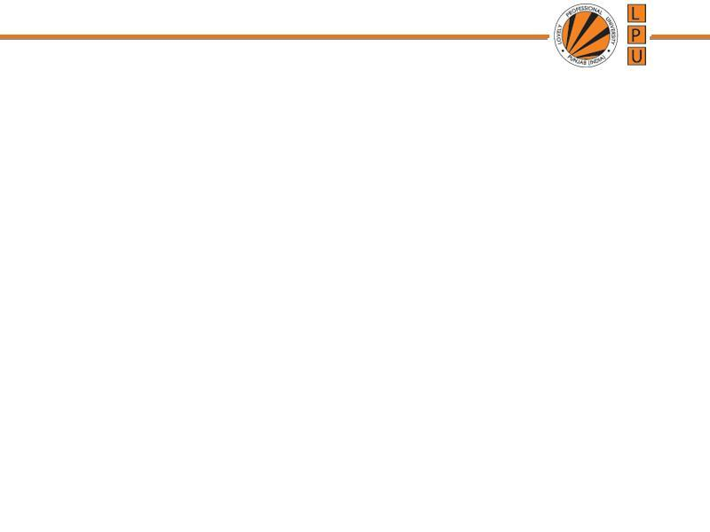
UNIT-4 Deadlocks
Notes:
1
1

Slide 2
Deadlock : Deadlock Characterization, Handling of deadlocks- Deadlock Prevention, Deadlock Avoidance & Detection, Deadlock Recovery, Starvation
Protection and Security : Need for Security, Security Vulnerability like Buffer overflow, Trapdoors, Backdoors, cache poisoning etc, Authentication-Password based Authentication, Password
Maintenance & Secure Communication, Application Security - Virus, Program Threats, Goals of protection, Principles of protection, Domain of protection, Access matrix, Implementation of access matrix, System and network threats, Examples of attacks

Slide 3
The Deadlock Problem
A deadlock consists of a set of blocked processes, each holding a resource and waiting to acquire a resource held by another process in the set
Example
A system has 2 disk drives
P₁ and P₂ each hold one disk drive and each needs the other one
Example
Semaphores A and B, initialized to 1
P₀ P₁
wait (A); wait(B)‏
wait (B); wait(A)‏
Notes:
3
3

Slide 4
System Model
Resource types R₁, R₂, . . ., R_{m}
CPU cycles, memory space, I/O devices
Each resource type R_{i} has 1 or more instances
Each process utilizes a resource as follows:
Request : Process Pi requests for resource, if request is not guaranteed, Pi must wait until it acquires resource
Use : Process can operate on resource ( can use that resource)
Release: Process releases the resource ( after using)
Request and Release resource are System Calls, done through wait() and signal()
Notes:
5
5

Slide 5
Bridge Crossing Example
Traffic only in one direction
The resource is a one-lane bridge
If a deadlock occurs, it can be resolved if one car backs up (pre-empt resources and rollback)‏
Several cars may have to be backed up if a deadlock occurs
Starvation is possible
Notes:
4
4

Slide 6
Deadlock Characterization
Necessary Conditions for Deadlock to Occur:
Deadlock can arise if four conditions hold simultaneously.
These conditions must occur for deadlock to occur.
1. Mutual Exclusion: only one process at a time can use a resource
2. Hold and Wait: a process holding at least one resource is waiting to acquire additional resources held by other processes
Notes:
6
6

Slide 7
Deadlock Characterization
Necessary Conditions for Deadlock to Occur:
Deadlock can arise if four conditions hold simultaneously.
3. No Pre-emption: a resource can be released only voluntarily by the process holding it after that process has completed its task, resources can’t be pre-empted
4. Circular Wait: There exists a set {P₀, P₁, …, P₀} of waiting processes such that P₀ is waiting for a resource that is held by P₁, P₁ is waiting for a resource that is held by P₂, …, P_{n–1} is waiting for a resource that is held by P_{n}, and P_{n} is waiting for a resource that is held by P_{0.}
Notes:
7
7

Slide 8
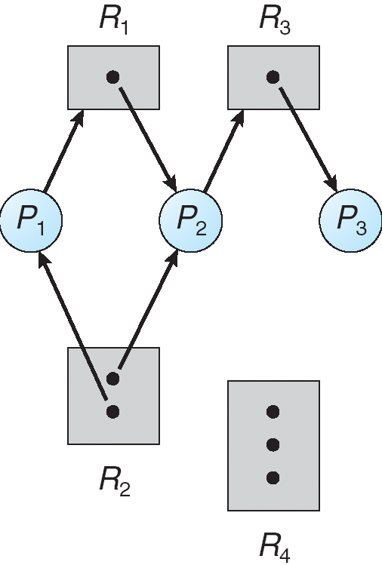
Representation of Deadlock
Resource-Allocation Graph
Deadlocks can be described in terms of Directed Graph, called Resource Allocation Graph.
Set of vertices V and a set of edges E.
V is partitioned into two types:
P = {P₁, P₂, …, P_{n}}, the set consisting of all active processes in the system R = {R₁, R₂, …, R_{m}}, the set consisting of all resource types in the system
Notes:
8
8

Slide 9
Resource-Allocation Graph
Request Edge – directed edge P_{i} → R_{j}
Process Pi is requesting for instance of Resource Rj
Assignment Edge – directed edge R_{j} → P_{i}
Resource Rj is allocated to process Pi.
Notes:
9
9

Slide 10
Resource-Allocation Graph (Cont.)‏
Process
Resource Type with 4 instances
P_{i} requests instance of R_{j}
P_{i} is holding an instance of R_{j}
P_{i}
R_{j}
P_{i}
R_{j}
Notes:
10
10

Slide 11
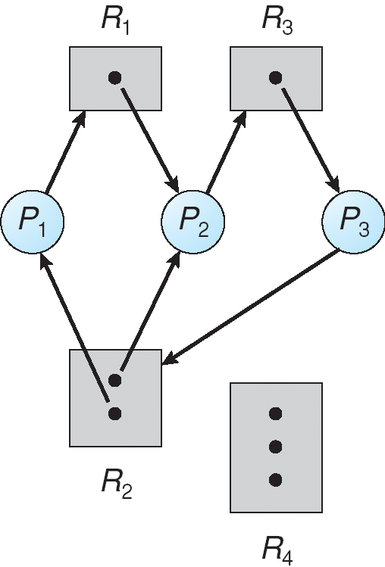
Resource Allocation Graph With A Deadlock
Before P₃ requested an instance of R₂
After P₃ requested an instance of R₂
Notes:
11
11

Slide 12
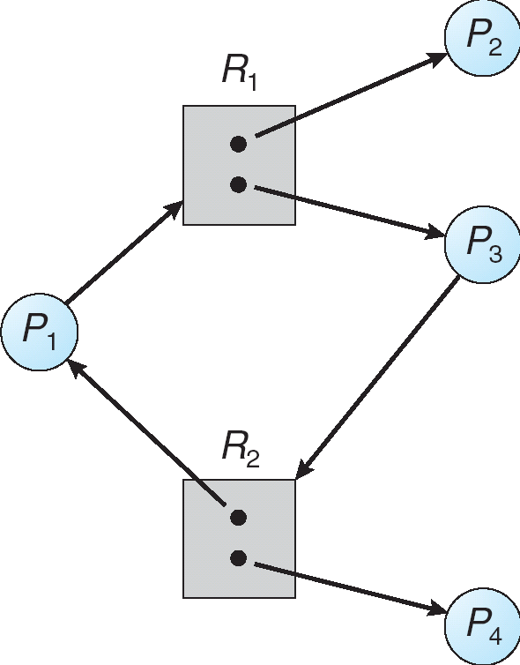
Graph With A Cycle But No Deadlock
Process P₄ may release its instance of resource type R₂. That resource can then be allocated to P3, thereby breaking the cycle.
Notes:
12
12

Slide 13
Relationship of cycles to deadlocks
If a resource allocation graph contains no cycles ⇒ no deadlock
If a resource allocation graph contains a cycle and if only one instance exists per resource type ⇒ deadlock
If a resource allocation graph contains a cycle and if several instances exists per resource type ⇒ possibility of deadlock
Notes:
13
13

Slide 14
Methods for Handling Deadlocks
Prevention
Ensure that the system will never enter a deadlock state
Avoidance
Ensure that the system will never enter an unsafe state
Detection
Allow the system to enter a deadlock state and then recover
Do Nothing
Ignore the problem and let the user or system administrator respond to the problem; used by most operating systems, including Windows and UNIX
Notes:
14
14

Slide 15
1. Deadlock Prevention
Deadlock Prevention Methods: Prevent deadlocks by making a constraint on how requests for resources can be made
Mutual Exclusion – The mutual-exclusion condition must hold for non-sharable resources
(Where as) Shared resources such as read-only files do not lead to deadlocks.
Some resources, such as printers and tape drives, require exclusive access by a single process.
Notes:
15
15

Slide 16
Deadlock Prevention
Hold and Wait – we must guarantee that whenever a process requests a resource, it does not hold any other resources
1. Allocate all its resources before process begins execution
2. Allow a process to request resources only when the process has no resource
Drawback / Result: Low resource utilization; starvation possible
Notes:
16
16

Slide 17
Deadlock Prevention (Cont.)‏
No Pre-emption:
One approach is that if a process is forced to wait when it requests new resources, then all resources previously held by this process are implicitly released, ( preempted ), forcing this process to re-acquire the old resources along with the new resources in a single request (if one process goes to waiting state all its previously held resources must be released implicitly)
Pre-empted resources are added to the list of resources for which the process is waiting
A process will be restarted only when it can regain its old resources, as well as the new ones that it is requesting
Notes:
17
17

Slide 18
Deadlock Prevention (Cont.)‏
Circular Wait
One way to avoid circular wait is to number all resources, and to require that processes request resources only in strictly increasing ( or decreasing ) order.
In other words, in order to request resource Rj, a process must first release all Ri such that i >= j.
Assign a number to resources. If R7 is requested by process no other resource lower than 7 can be granted to process.
In case process needs R3, then it will have to release R7 in order to get R3.
One big challenge in this scheme is determining the relative ordering of the different resources
Notes:
18
18

Slide 19
2. Deadlock Avoidance
Requires that the system has some additional a priori information available.
Each process declare the maximum number of resources of each type that it may need
The deadlock-avoidance algorithm dynamically examines the resource-allocation state to ensure that there can never be a circular-wait condition
A resource-allocation state is defined by the number of available and allocated resources, and the maximum demands of the processes
Notes:
19
19

Slide 20
State and Safe State
State: State of system represents currently allocated resources to the process. (data held by process at sometime)
Safe State: If the system can allocate available resources to the process in some order to avoid deadlock.
Unsafe State:
OS can not prevent processes from requesting the resources
Allocating the resources, which may leads to deadlock.
Notes:
20
20

Slide 21
Safe State
A system is in a safe state only if there exists a safe sequence
if resources are allocated to the process in that sequence deadlock doesnot occur.
A sequence of processes <P₁, P₂, …, P_{n}> is a safe sequence,
If request made by process can be satisfied with the available resources + already held resources
Notes:
21
21

Slide 22
Safe State (continued)‏
If a system is in safe state ⇒ no deadlocks
If a system is in unsafe state ⇒ possibility of deadlock
Avoidance ⇒ ensure that a system will never enter an unsafe state
Notes:
22
22

Slide 23
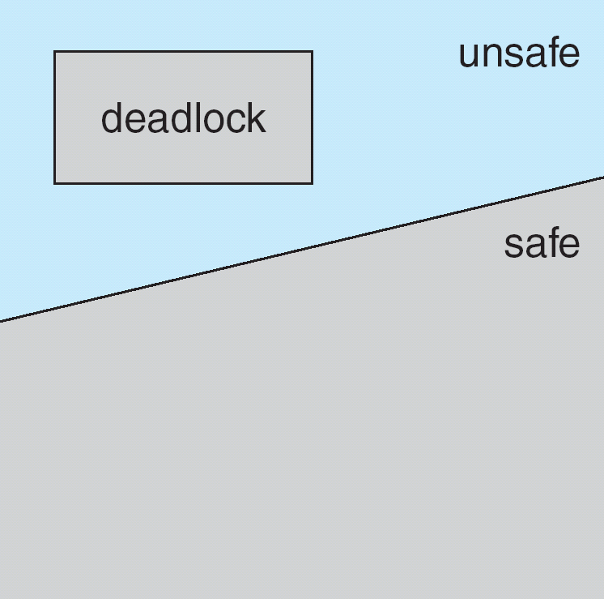
Safe, Unsafe , Deadlock State
Notes:
23
23

Slide 24
Example of safe and unsafe state
Consider system with 12 DVD and 3 processes: (p0, p1, p2
Process | Maximum Need | Currently Held | Need
P0 | 10 | 5 | 5
P1 | 4 | 2 | 2
P2 | 9 | 2 | 7
Notes:
24
24

Slide 25
Avoidance algorithms
For a single instance of a resource type, use a resource-allocation graph
For multiple instances of a resource type, use the banker’s algorithm
Notes:
25
25

Slide 26
Resource-Allocation Graph Scheme: For Single Instance
Introduce a new kind of edge called a claim edge (a dotted line)
Claim edge P_{i} R_{j} indicates that process P_{j} may request resource R_{j}; which is represented by a dashed line
A claim edge converts to a request edge when a process requests a resource
A request edge converts to an assignment edge when the resource is allocated to the process
When a resource is released by a process, an assignment edge reconverts to a claim edge
Resources must be claimed a priori in the system
Notes:
26
26

Slide 27
Resource-Allocation Graph Scheme: For Single Instance
Claim Edge →Request Edge : when a process requests a resource
Request edge → Assignment Edge : when the resource is allocated to the process to
Assignment edge → Claim Edge: When a resource is released by a process,
Notes:
27
27

Slide 28
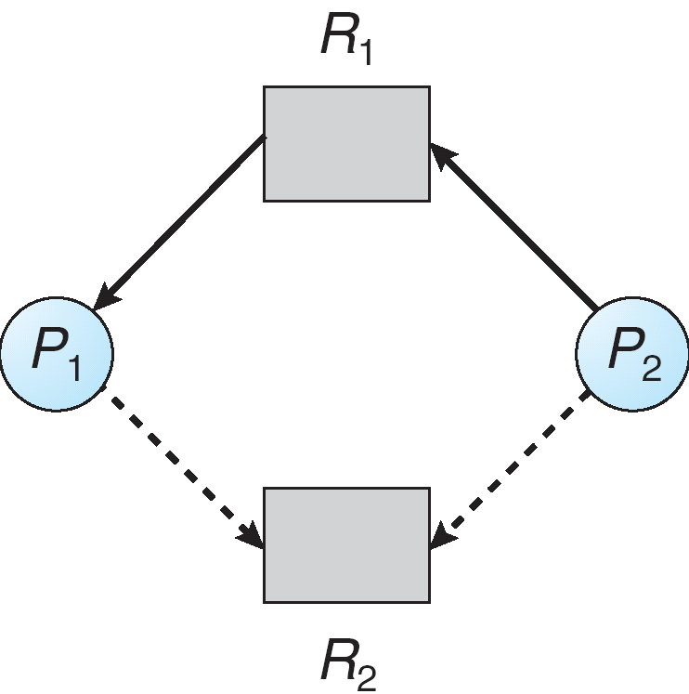
Resource-Allocation Graph with Claim Edges
Assignment
edge
Request
edge
Claim
edge
Claim
edge
Notes:
28
28

Slide 29
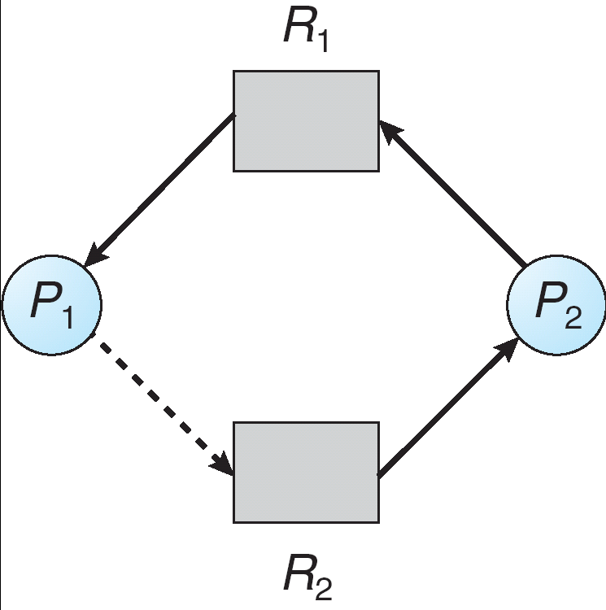
Unsafe State In Resource-Allocation Graph
Assignment
edge
Request
edge
Assignment
edge
Claim
edge
Notes:
29
29

Slide 30
Resource-Allocation Graph Algorithm: For Multiple Instances
Banker’s Algorithm
Used when there exists multiple instances of a resource type
Each process must priori claim maximum use
When a process requests a resource, it may have to wait
When a process gets all its resources, it must return them in a finite amount of time
Notes:
30
30

Slide 31
Data Structures for the Banker’s Algorithm
Let n = number of processes, and m = number of resources types.
i: Process and j: Resource instances
Available: Vector of length m.
If available [ j ] = k, there are k instances of resource type R_{j} available.
Max: Maximum available resources that a process can request.
If Max [ i , j ] = k, then process P_{i} may request at most k
instances of resource type R_{j}.
Notes:
31
31

Slide 32
Data Structures for the Banker’s Algorithm
Let n = number of processes, and m = number of resources types.
Allocation: Resources that can be allocated
If Allocation[ i , j ] = k then P_{i} is currently allocated k instances of R _{j.}
Need: if Need[ i, j ] = k, then P_{i} may need k more instances of R_{j} to complete its task.
Need[i,j] = Max[i,j] – Allocation [i,j]
Notes:
32
32

Slide 33
Bankers Algorithm
Let Request be the request vector for process P_{i}.
If Request_{i}[j] = k then process P_{i} wants k instances of resource type R_{j}
1. If Request_{i} ≤ Need_{i} go to step 2. Otherwise, raise error condition, since process has exceeded its maximum claim
2. If Request_{i} ≤ Available, go to step 3. Otherwise P_{i} must wait, since resources are not available
Notes:
33

Slide 34
Bankers Algorithm
3. Pretend to allocate requested resources to P_{i} by modifying the state as follows:
Available = Available - Request_{i}
Allocation_{i} = Allocation_{i} + Request_{i}
Need_{i} = Need_{i} – Request_{i}
If safe ⇒ the resources are allocated to P_{i}
If unsafe ⇒ P_{i} must wait, and the old resource-allocation state is restored
Notes:
34

Slide 35
Safety Algorithm
1. Let Work and Finish be vectors of length m and n, respectively. Initialize:
Work = Available
Finish[i] = false for i=0,1,..,n
//{Process I needs resources, resources are still available}
2. Find an i such that
Finish[i] = false AND Need_{i} ≤ Work
If no such i exists, go to step 4
3. Work = Work + Allocation_{i} Finish[i] = true go to step 2
4. If Finish[i] == true for all i, then the system is in a safe state
Notes:
35

Slide 36
Example: Bankers Algorithm
Consider a system with 5 processes P0 to P4, three resource types A,B,C. Resource A has 10 instances , B has 5 instances, C has 7 instances. Is system in safe state?
Available= [(10-7), (5-2), (7-5)] = < 3 3 2>
Need= Maximum – Allocation
Available = Available + Allocated
Safe Sequence<P1, P3, P4, P0, P2>
Process | Allocation | Maximum | Available | Need
 | A B C | A B C | A B C | A B C
P0 | 0 1 0 | 7 5 3 | 3 3 2 | 7 4 3
P1 | 2 0 0 | 3 2 2 |  | 1 2 2
P2 | 3 0 2 | 9 0 2 |  | 6 0 0
P3 | 2 1 1 | 2 2 2 |  | 0 1 1
P4 | 0 0 2 | 4 3 3 |  | 4 3 1
 | <7 2 5>
Notes:
36

Slide 37
Example: Bankers Algorithm
For p0: need>available
P1: need<available: update available matrix by
Available = Available + Allocated <5 3 2>
P2: can not be fulfilled
P3: Available = Available+allocated <7 4 3>
P4: Available = Available+allocated <7 4 5>
P0: Available = Available+allocated <7 5 5>
P2: Available = Available+allocated <10 5 7>
Safe seq: <P1, P3, P4, P0, P2>
Notes:
37

Slide 38
Example: Bankers Algorithm
Find: 1. Whether system is in safe state or not?
2. Safe sequence
Process | Allocation | Available | Need
 | A B C | A B C | A B C
P0 | 0 1 0 | 2 3 0 | 7 4 3
P1 | 3 0 2 |  | 0 2 0
P2 | 3 0 2 |  | 6 0 0
P3 | 2 1 1 |  | 0 1 1
P4 | 0 0 2 |  | 4 3 1
Notes:
38

Slide 39
Deadlock Detection
Notes:
39
39

Slide 40
Deadlock Detection
For deadlock detection, the system must provide
An algorithm that examines the state of the system to detect whether a deadlock has occurred
An algorithm to recover from the deadlock
Notes:
40
40

Slide 41
For Single Instance of Each Resource Type
Requires the creation and maintenance of a wait-for graph
The graph is obtained by removing the resource nodes from a resource-allocation graph and collapsing the appropriate edges
P_{i} → R_{q} R_{q} → P_{j}
P_{i} → P_{j} if P_{i} is waiting for resource held by P_{j}.
If there is a cycle in Wait-for-Graph, there exists a deadlock
Notes:
41
41

Slide 42
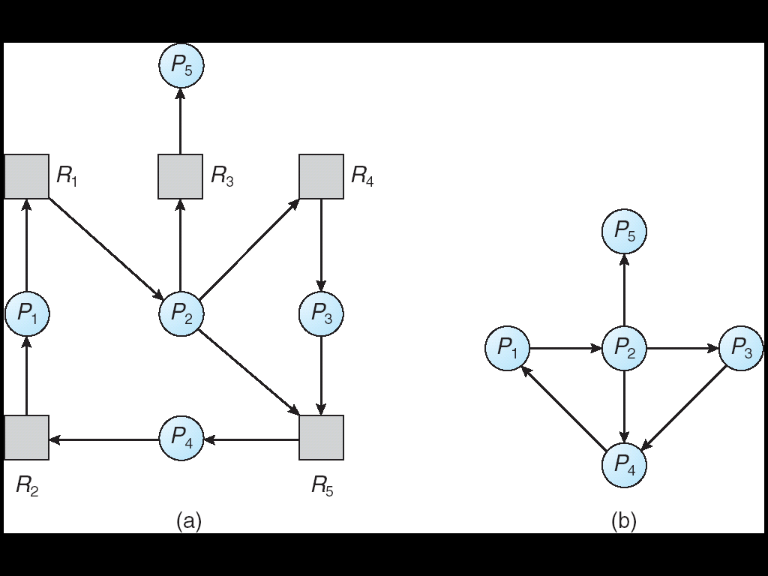
Resource-Allocation Graph and Wait-for Graph
Resource-Allocation Graph
Corresponding wait-for graph
Notes:
42
42

Slide 43
For Multiple Instances of a Resource Type
Required data structures:
Available: A vector of length m indicates the number of available resources of each resource type.
Allocation: An n x m matrix defines the number of resources of each type currently allocated to each process.
Request: An n x m matrix indicates the current request of each process. If Request [ i , j ] = k, then process P _{i} is requesting k more instances of resource type. R _{j}.
Notes:
43
43

Slide 44
Detection Algorithm
1. Let Work and Finish be vectors of length m and n, respectively. Initialize:
Work = Available_{m}
Finish[i] = false if Allocation !=0
= true if Allocation = 0
Request_{i} ≤ Work
2. Find an i such that
Finish[i] = false AND Request_{i} ≤ Work
If no such i exists, go to step 4
If resources are available:
3. Work = Work + Allocation_{i} Finish[i] = true go to step 2
4. If Finish[i] == False for some i then there is a deadlock.
Notes:
44

Slide 45
Example: Deadlock Detection
In above situation, there is no dead lock. But if P2 needs more resources < 0 0 1>
System in in Deadlock now, because no available resources.
Process | Allocation | Request | Available
 | A B C | A B C | A B C
P0 | 0 1 0 | 0 0 0 | 0 0 0
P1 | 2 0 0 | 2 0 2
P2 | 3 0 3 | 0 0 0 <0 0 1>
P3 | 2 1 1 | 1 0 0
P4 | 0 0 2 | 0 0 2
 | <7 2 6>
Notes:
45

Slide 46
Detection-Algorithm Usage
To invoke the detection algorithm depends on:
How often is a deadlock likely to occur?
How many processes will be affected by deadlock when it happens?
If the detection algorithm is invoked randomly:
difficult to tell which process “caused” the deadlock
If the detection algorithm is invoked for every resource request:
will incur a overhead in computation time
A less expensive alternative is to invoke the algorithm when CPU utilization drops below 40%.
Notes:
46
46

Slide 47
Recovery From Deadlock
Notes:
47
47

Slide 48
Recovery from Deadlock
Let the user or system administrator respond to the problem
Two Approaches:
Process termination : terminate processes to break the circular wait.
Resource Pre-emption : Pre-empt resources from deadlocked processes
Notes:
48
48

Slide 49
Process Termination
Abort all deadlocked processes
This approach will break the deadlock, but at great expense
Abort one process at a time until the deadlock cycle is eliminated
After each process is aborted, a deadlock-detection algorithm must be re-invoked to determine whether any processes are still deadlocked
Many factors may affect which process is chosen for termination
What is the priority of the process?
How much process has run and how much time it needs to complete?
How many and what type of resources has the process used?
How many more resources does the process need in order to finish its task?
How many processes will need to be terminated?
Is the process interactive or batch?
Notes:
49
49

Slide 50
Resource Pre-emption
Pre-empt some resources from processes and give these resources to other processes until the deadlock cycle is broken
When pre-emption is required to deal with deadlocks, then three issues need to be addressed:
Selecting a victim – Which resources and which processes are to be pre-empted?
Rollback – If we pre-empt a resource from a process, what should be done with that process?
Starvation – How do we ensure that starvation will not occur?
That is, how can we guarantee that resources will not always be pre-empted from the same process?
Notes:
50
50

Slide 51
Summary
Four necessary conditions must hold in the system for a deadlock to occur
Mutual exclusion
Hold and wait
No preemption
Circular wait
Four principal methods for dealing with deadlocks
Use some protocol to (1) prevent or (2) avoid deadlocks, ensuring that the system will never enter a deadlock state
Allow the system to enter a deadlock state, (3) detect it, and then recover
Recover by process termination or resource preemption
(4) Do nothing; ignore the problem altogether and pretend that deadlocks never occur in the system (used by Windows and Unix)‏
To prevent deadlocks, we can ensure that at least one of the four necessary conditions never holds
Notes:
51
51

